Slide 1
KERNAL BLAS – GPU610
Presenters: Joseph Pham and Shan Ariel Sioson

Slide 2
Table of contents
Assignment 1(What we chose)
Calculation of PI
Data compression
Assignment 2
Offloading to GPU
CPU vs GPU results
Assignment 3
Optimized kernel
Test runs and results

Slide 3
Calculation of pi
A circle with radius r in a squre with side length 2r
The area of the circle is πr² and the area of the square is 4r²
The ratio of the area of the circle to the area of the square is: πr² / 4r² = π / 4
If you randomly generate N points inside the square, approximately N * π / 4 of those points (M) should fall inside the circle.
π is then approximated as:
N * π / 4 = M
π / 4 = M / N
π = 4 * M / N

Slide 4
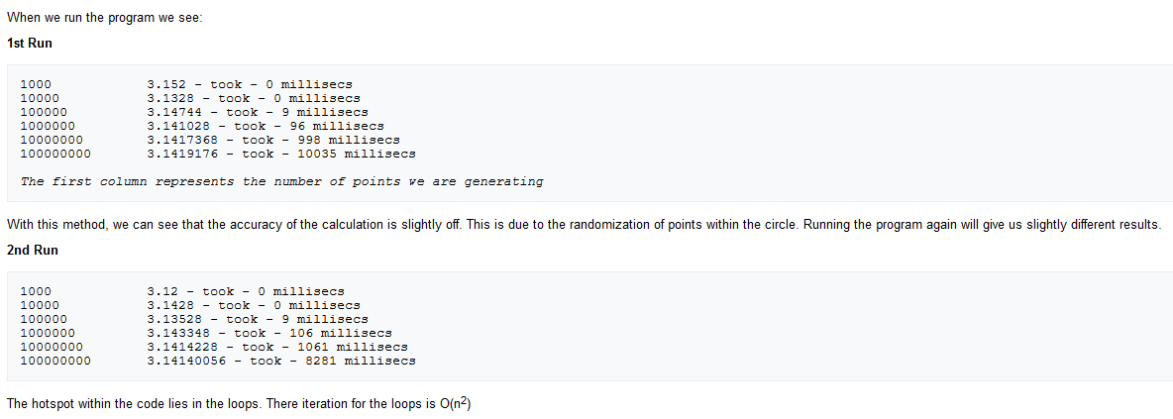

Slide 5
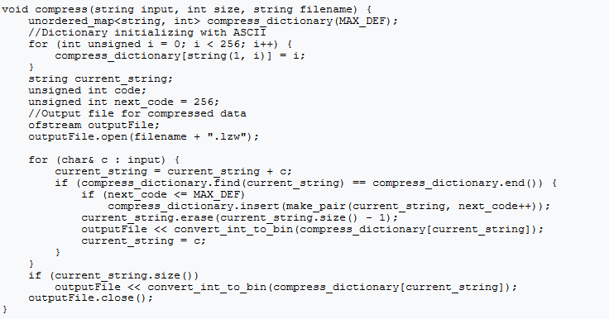
Data compression
LZW Algorithm
Suggested parallelization: None found

Slide 6
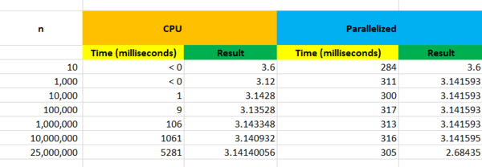
Part 2
Offloading to GPU results
As we can see above, the more iterations, the more accurate the calculation of PI. The CPU's results drastically change as we increase the iteration 10x. However, the parallelized results seem to stay accurate throughout the iterations.
Profiling the code shows that memcpy takes up most of the time spent. Even when there are 10 iterations, the time remains at 300 milliseconds. As the iteration passes 25 million, we have a bit of memory leak which results in inaccurate results.

Slide 7
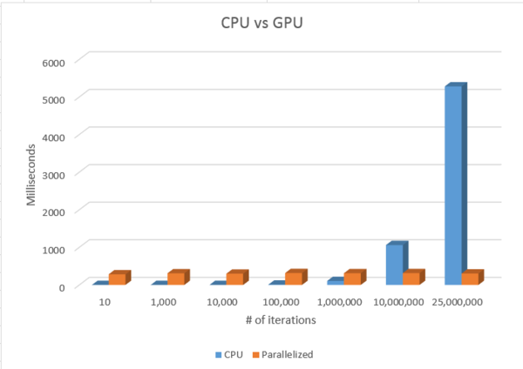

Slide 8
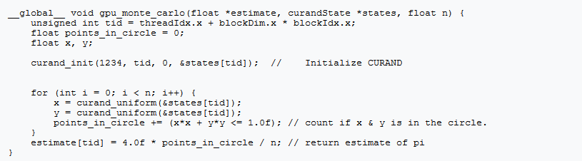
Part 3
Optimization in kernel

Slide 9
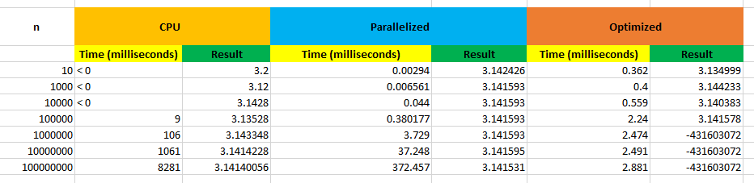
Run results

